Slide 1



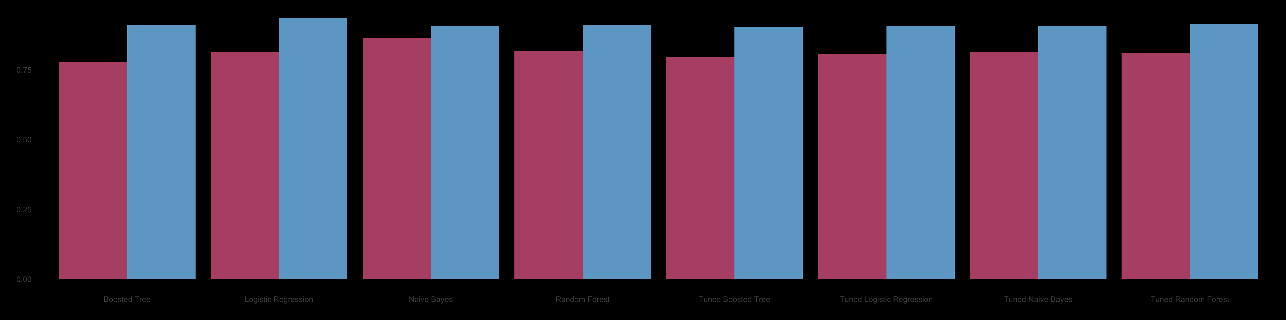
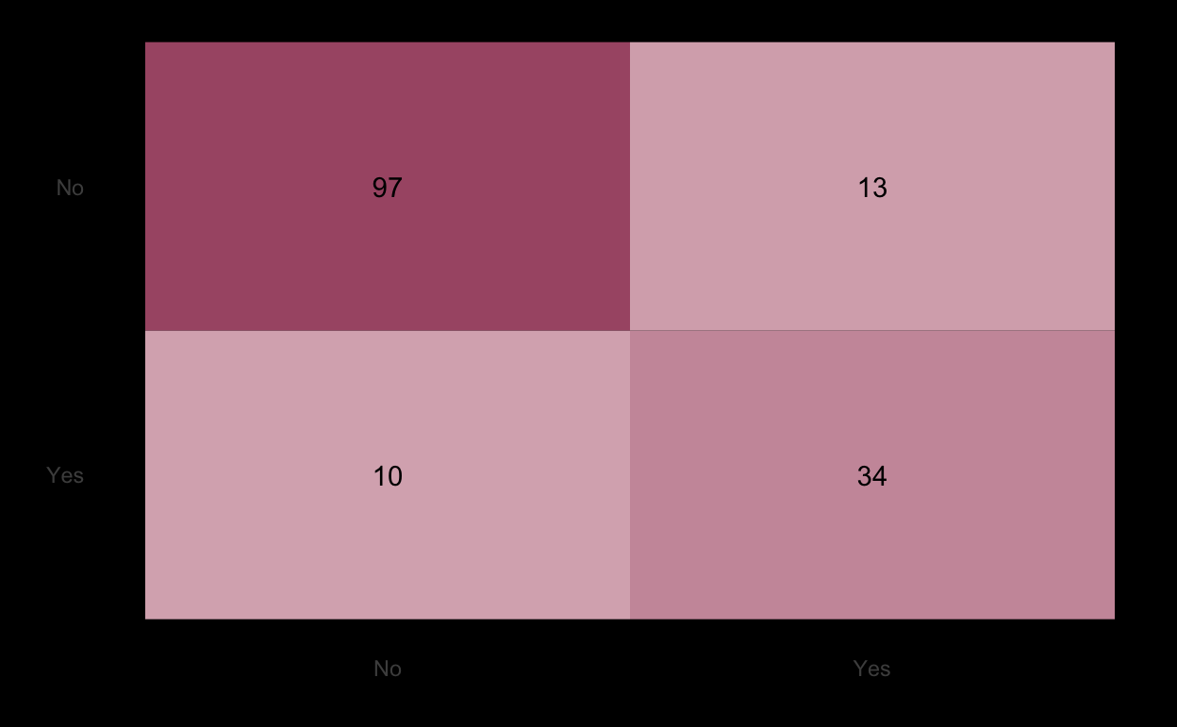
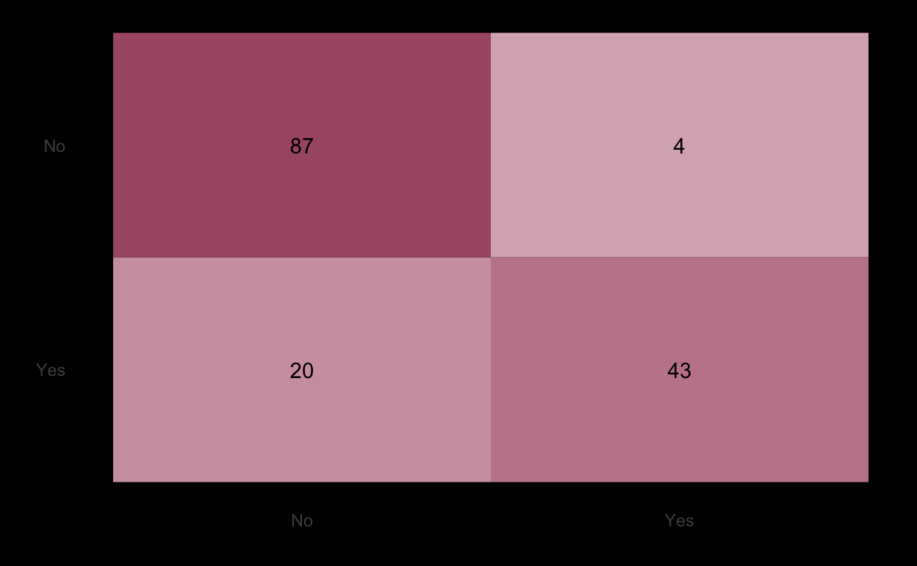
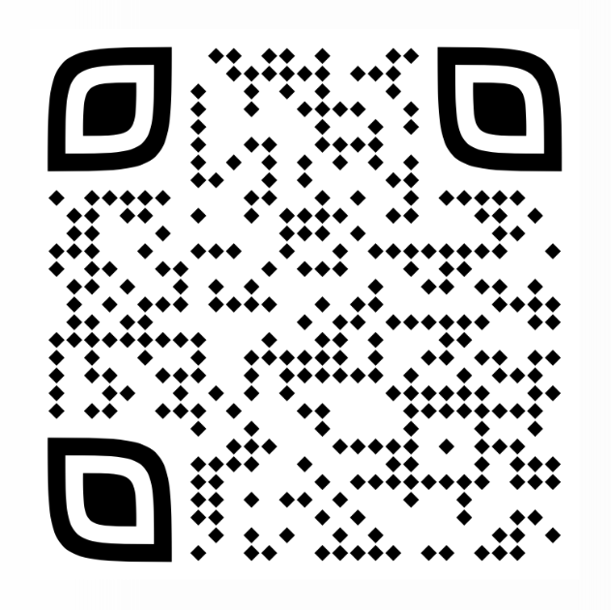
Detecting Suicidal Ideation Among LGBTQ+ Individuals:
Comparing Machine Learning Models
Mary Kate Durka, Natalie Newton, Julia Suciu, Amanda Batista, Natali Barragan,
Sean Sachs, Alika Tsytsurina, Nicole A. Roberts, & Mary H. Burleson
Introduction
Mental Health Among LGBTQ+
Increasing suicide rates over the past several decades pose an ever-growing concern to society. Of particular concern are sexual minority communities which report higher levels of depression, anxiety, difficulties in emotion regulation, and suicidality (Wittgens, et al., 2022; Hatzenbuehler, et al., 2008; Kapatais, et al., 2023)
Bisexual individuals make up the largest group among sexual minorities, and within our sample, while consistently reporting worse mental health outcomes when compared to both heterosexual and homosexual individuals; this includes higher risk of depression, anxiety, self-harm, suicidality, alcohol or drug abuse, and lower physical health (Wittgens, et al., 2022; Hickson et al., 2017; Borgogna et al., 2019; Ross et al., 2018; Feinstein, et al., 2017).
The Current Study
Methods
All analyses were conducted on data collected online in 2024 through Connect, an online data collection platform.
625 sexual minority individuals in romantic relationships were recruited (n=109 lesbian; n=102 gay; n=395 bisexual; n=19 other; mean age = 34.5).
Models were constructed to predict the presence of suicidal ideation at any level within the past two weeks (item taken from the BDI-II, Beck, et al., 1996).
The Current Study Cont.
Measures
Using a Random Forest engine, we created an initial model to narrow down predictors in the larger dataset to the 10 most important questionnaires.
Predictors fell into four main categories:
Mental Health
Beck Depression Inventory-II, State-Trait Anxiety Inventory, Perceived Stress Scale (Beck et al., 1996; Spielberger, 1983; Cohen, et al., 1983)
Sexual Minority Stressors
Internalized Homonegativity-Revised: personal internalized homonegativity subscale, Sexual Orientation Concealment Scale-Revised, Stigma Consciousness Scale-Revised (Mayfield, 2001; Jackson & Mohr, 2016; Pinel, 1999)
Mood and Emotion Regulation
Positive and Negative Affect Schedule: negative affect scale; Negative Mood Regulation Scale; Difficulties in Emotion Regulation (Watson, et al., 1988; Catanzaro & Mearns, 1990; Gratz & Roemer, 2004)
Attachment Avoidance
Experiences in Close Relationships: avoidance subscale (Fraley et al., 2000)
Four initial models were tested to predict the presence of any suicidal ideation:
Naïve Bayes, Random Forest, Logistic Regression, Boosted Tree.
We tuned the models to try improving performance, but it resulted in over-fitting the data.
The naïve bayes model performed best in predicting suicidal ideation, while the logistic regression model was a close second. All models consistently performed extremely well.
0.75
0.50
0.25
0.00
Balanced Accuracy
Model Comparison: Balanced Accuracy and ROC AUC
ROC AUC
Boosted Tree
Logistic Regression
Naïve Bayes
Random Forest
Tuned Boosted Tree
Tuned Logistic Regression
Tuned Naïve Bayes
Tuned Random Forest
Confusion Matrix: Logistic Regression Model
Performance Metrics for All Models
Confusion Matrix: Naïve Bayes Model
Discussion
Predicted
Non-Suicidal
Suicidal
97
13
Predicted
Non-Suicidal
Suicidal
87
4
10
34
20
43
Non-Suicidal Suicidal
Non-Suicidal Suicidal
Truth
Truth
Model | Balanced Accuracy | ROC AUC | Model | Balanced Accuracy | ROC AUC
Boosted Tree | 0.78 | 0.91 | Tuned Boosted Tree | 0.80 | 0.91
Logistic Regression | 0.82 | 0.94 | Tuned Logistic Regression | 0.81 | 0.91
Naïve Bayes | 0.86 | 0.91 | Tuned Naïve Bayes | 0.82 | 0.91
Random Forest | 0.82 | 0.91 | Tuned Random Forest | 0.81 | 0.92
Naïve bayes is an appropriate model to use to detect suicidal ideation extremely accurately, however, all models performed very well. This indicates excellent reproducibility for all models and that the predictors chosen are appropriate.
Incorporating emotion-related factors in identifying individuals with a higher risk of suicidal ideation outside of a clinical setting can help ensure that resources are available to them, rather than relying strictly on the diagnosis of mood disorders such as depression or anxiety among people already seeking treatment.
Focusing on a sexual minority sample allows us to develop a model that may better detect suicidality than models trained using a sexual majority sample.
Digital poster
and
references

Slide 2
Detecting Suicidal Ideation Among LGBTQ+ Individuals:
Comparing Machine Learning Models
Mary Kate Durka, Natalie Newton, Julia Suciu, Amanda Batista, Natali Barragan,
Sean Sachs, Alika Tsytsurina, Nicole A. Roberts, & Mary H. Burleson
References
Beck, A. T., Steer, R. A., Ball, R., & Ranieri, W. F. (1996). Comparison of Beck Depression Inventorys -IA and -II in psychiatric outpatients. Journal of Personality Assessment, 67(3), 588–597. https://doi.org/10.1207/s15327752jpa6703_13
Borgogna, N. C., McDermott, R. C., Aita, S. L., & Kridel, M. M. (2019). Anxiety and depression across gender and sexual minorities: Implications for transgender, gender nonconforming, pansexual, demisexual, asexual, queer, and questioning individuals. Psychology of Sexual Orientation and Gender Diversity, 6(1), 54-63. https://doi.org/10.1037/sgd0000306
Catanzaro, S. J., & Mearns, J. (1990). Measuring generalized expectancies for negative mood regulation: Initial scale development and implications. Journal of Personality Assessment, 54(3–4), 546–563. https://doi.org/10.1080/00223891.1990.9674019
Cohen, S., Kamarck, T., and Mermelstein, R. (1983). A global measure of perceived stress. Journal of Health and Social Behavior, 24, 386-396.
Feinstein, B. A., Dyar, C., & London, B. (2017). Are outness and community involvement risk or protective factors for alcohol and drug abuse among sexual minority women? Archives of Sexual Behavior, 46(5), 1411–1423. https://doi.org/10.1007/s10508-016-0790-7
Fraley, R. C., Waller, N. G., & Brennan, K. A. (2000). An item-response theory analysis of self-report measures of adult attachment. Journal of Personality and Social Psychology, 78, 350-365. https://doi.org/10.1037/0022-3514.78.2.350
Gratz, K. L., & Roemer, L. (2004). Multidimensional Assessment of Emotion Regulation and Dysregulation: Development, Factor Structure, and Initial Validation of the Difficulties in Emotion Regulation Scale. Journal of Psychopathology and Behavioral Assessment, 26(1), 41–54. https://doi.org/10.1023/B:JOBA.0000007455.08539.94
Hatzenbuehler, M. L., McLaughlin, K. A., & Nolen-Hoeksema, S. (2008). Emotion regulation and internalizing symptoms in a longitudinal study of sexual minority and heterosexual adolescents. Journal of Child Psychology and Psychiatry, 49(12), 1270–1278. https://doi.org/10.1111/j.1469-7610.2008.01924.x
Hickson, F., Davey, C., Reid, D., Weatherburn, P., & Bourne, A. (2017). Mental health inequalities among gay and bisexual men in England, Scotland and Wales: A large community-based cross-sectional survey. Journal of Public Health (Oxford, England), 39(2), 266–273. https://doi.org/10.1093/pubmed/fdw021p
Jackson, S. D., & Mohr, J. J. (2016). Conceptualizing the closet: Differentiating stigma concealment and nondisclosure processes. Psychology of Sexual Orientation and Gender Diversity, 3(1), 80-92. https://dx.doi.org/10.1037/sgd0000147
Kapatais, A., Williams, A. J., & Townsend, E. (2023). The Mediating Role of Emotion Regulation on Self-harm among Gender Identity and Sexual Orientation Minority (LGBTQ+) Individuals. Archives of Suicide Research, 27(2), 165–178. https://doi.org/10.1080/13811118.2022.2064254
Mayfield, W. (2001). The Development of an Internalized Homonegativity Inventory for Gay Men. Journal of Homosexuality, 41(2), 53–76. https://doi.org/10.1300/J082v41n02_04
Ross, L. E., Salway, T., Tarasoff, L. A., MacKay, J. M., Hawkins, B. W., & Fehr, C. P. (2018). Prevalence of depression and anxiety among bisexual people compared to gay, lesbian, and heterosexual individuals: A systematic review and meta-analysis. The Journal of Sex Research, 55(4–5), 435–456. https://doi.org/10.1080/00224499.2017.1387755
Sowe, B. J., Taylor, A3 J., & Brown, J. (2017). Religious anti-gay prejudice as a predictor of mental health, abuse, and substance use. American Journal of Orthopsychiatry, 87(6), 690-703. https://doi.org/10.1037/ort0000297365
Spielberger, C. D. (1983). Manual for the State-Trait Anxiety Inventory (STAI). PaloAlto, CA: Consulting Psychologists Press.
Stigma consciousness: The psychological legacy of social stereotypes. Journal of Personality and Social Psychology, 76(1), 114-128. https://dx.doi.org/10.1037/0022-3514.76.1.114.
Watson, D., Clark, L. A., & Tellegen, A. (1988). Development and validation of brief measures of positive and negative Affect: The PANAS Scales. Journal of Personality and Social Psychology, 54(6), 1063–1070. https://doi.org/10.1037/0022-3514.54.6.1063
Wittgens, C., Fischer, M. M., Buspavanich, P., Theobald, S., Schweizer, K., & Trautmann, S. (2022). Mental health in people with minority sexual orientations: A meta‐analysis of population‐based studies. Acta Psychiatrica Scandinavica, 145(4), 357–372. https://doi.org/10.1111/acps.13405

